Slide 1
Vehicle Technology
Unit 3, Lesson 1

Slide 2
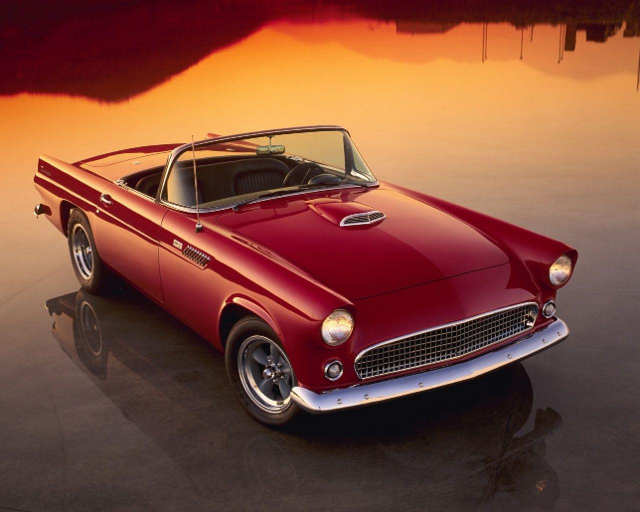
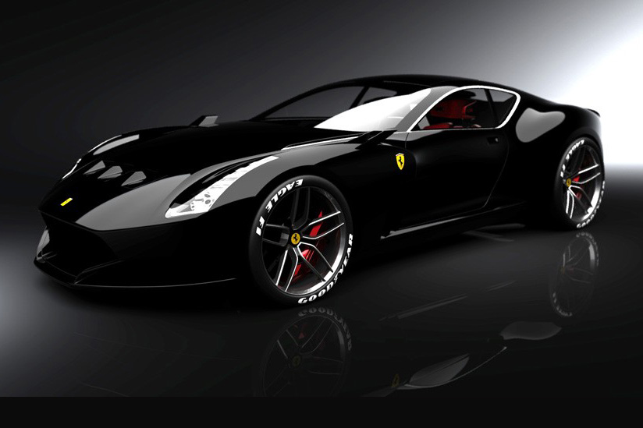
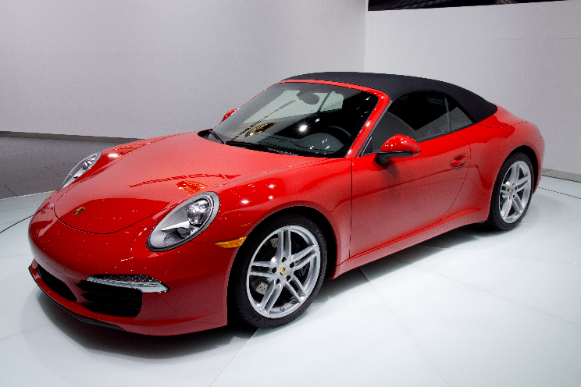

Slide 3
Economical and Environmental friendly ways to power automobiles, buses, and planes
E85 ethanol contains far fewer potential contaminants than found in gasoline.
U.S. Department of Energy says vehicles fueled with E85 ethanol have lower carbon monoxide and carbon dioxide emissions
Ethanol reduces exhaust VOC emissions by 12%.
Ethanol reduces toxic emissions by 30%.
Reduces the consumer cost of gasoline by extending the supply.
Provides an alternative to costly imported oil.
Gives leverage to independent gasoline marketers competing against larger, more powerful oil companies

Slide 4
The market for ethanol vehicles
America’s top automakers recommend the use of oxygenated fuels such as ethanol blends because of their clean air benefits and performance qualities.
At least 38 different models for sale in the U.S. are E85 ethanol flex-fuel capable.
Most manufacturers identify E85 ethanol flex-fuel vehicles with yellow gas caps and "Flex Fuel E85" badges.

Slide 5
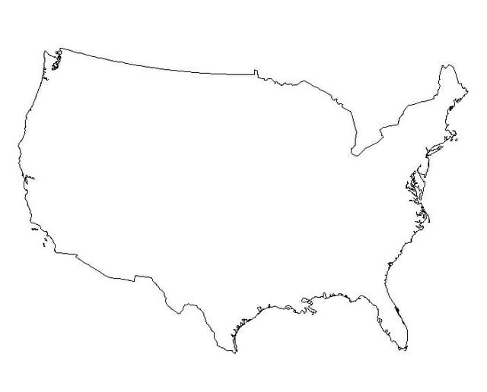
Ethanol vehicle market will continue to grow
Millions of cars powered by ethanol-blended gasoline are on America’s roads, and the number continues to grow.
Ethanol’s original use was as a gas extender when foreign oil prices skyrocketed in the 1970s.
Ethanol became popular as a high-quality octane booster.
Ethanol-blended gasoline sales represent over 15 percent of all automotive fuels sold in the United States.

Slide 6
Ethanol vehicle market will continue to grow
Many Midwestern states and federal government vehicles operate on variable fuel vehicles in their fleets.
These vehicles are capable of operating on E85, a blend of 85 percent ethanol and 15 percent unleaded gasoline.
The small percentage of unleaded gasoline in E85 fuels enhances starting in extremely cold weather.

Slide 7
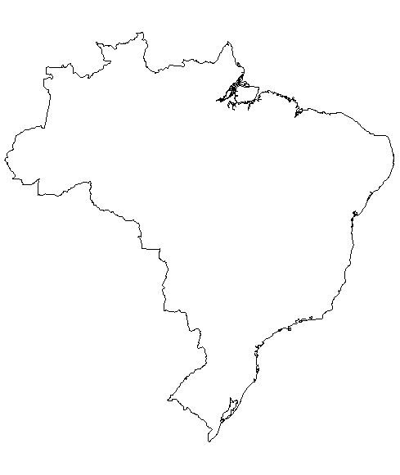
Ethanol vehicle market will continue to grow
Brazil is the largest transportation fuels market in the world for ethanol.
Brazil has used ethanol blends since 1939.
High oil prices in the 1970s prompted a government mandate in Brazil to produce vehicles fueled by pure ethanol to reduce dependence on foreign oil and provide value-added markets for its sugar cane producers.
Brazil consumes more than 330 thousand barrels of ethanol per day.
Two of the oxygenates used in reformulated gasoline that is required in certain ozone nonattainment areas in the U.S. are Ethanol and ETBE.

